Slide 1
Pet Care Management system
An Interactive Solution for Pet Health and Initial Remedies

Slide 2
Presented By : Fardin - 874 Usha - 982 Boshra - 721 Maria - 791 Adib - 694

Slide 3
Introduction
Objective:
To offer a user-friendly platform enabling pet owners to manage pet health and address common issues effectively
Key Features:
Disease Submission Form: Easily report your pet’s health condition
Automatic Remedy Suggestions: Tailored solutions for each disease type
Editable Records Table: Manage and modify your pet’s health records

Slide 4
Disease Types Supported:
01
02
03
Fleas
Worms
Allergies
04
05
Diarrhea
Injuries
- Bathe your pet using a flea shampoo.
- Use flea combs and regularly vacuum the pet's bedding and surrounding areas.
- Consult your vet for effective flea medication.
- Administer deworming medication recommended by your vet.
- Maintain cleanliness in your pet’s living area.
- Avoid raw or undercooked meat in your pet’s diet.
- Identify and remove allergens (e.g., specific foods or environmental irritants).
- Use hypoallergenic shampoos for skin allergies.
- Consult your vet for antihistamines or other allergy treatments.
- Ensure your pet stays hydrated; provide clean water.
- Offer bland food like boiled chicken and rice.
- If symptoms persist for more than 24 hours, consult your vet.
- Clean minor wounds with warm water and antiseptic solution.
- Apply a pet-safe antibiotic ointment.
- For severe injuries, bleeding, or fractures, seek immediate veterinary care.

Slide 5
Introduction
You can give a brief description of the topic you want to talk about here. For example, if you want to talk about Mercury, you can say that it’s the smallest planet in the entire Solar System

Slide 6
Popular pets
Guinea Pig
Dog
Cat
Bird

Slide 7
Important pet care
Food
Cleaning
Health
Play
Walk
Veterinarian

Slide 8
User Workflow
A step by step guide to use Pet Care website

Slide 9
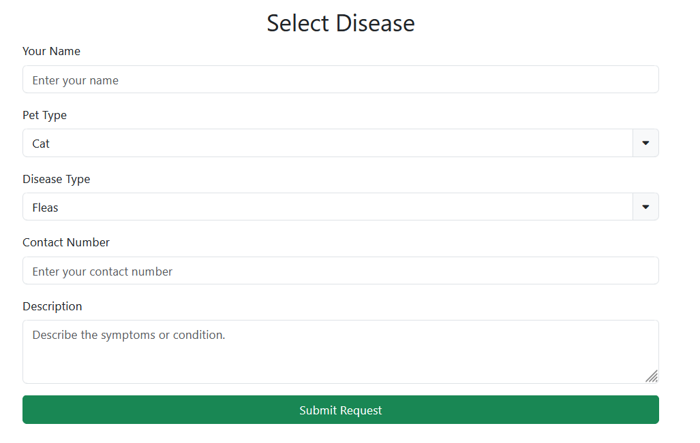
01.
Complete the disease submission form with pet details, disease type, and more.

Slide 10
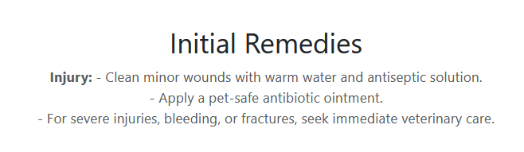
02.
Submit the form to receive suggested remedies instantly.

Slide 11
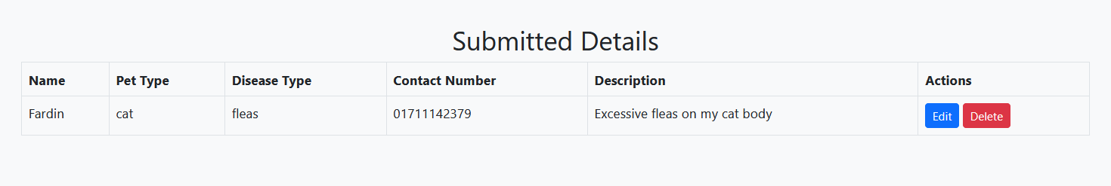
03.
View and manage your pet’s health records in the editable table.

Slide 12
Technology Stack Used
Frontend:
HTML5 & CSS3
Bootstrap for responsive design
Backend:
JavaScript for dynamic functionality
Additional Tools:
Font Awesome for icons

Slide 13
Code Overview
Key Components:
Disease Submission Form
Dynamic Table for Records
Remedy Display Section
Logic Highlights:
JavaScript event listeners for seamless interactivity
Disease-to-remedy mapping using objects
Form reset upon submission

Slide 14
Challenges and Solutions
Challenge 1:
Difficulty in updating remedies dynamically based on user input.
Solution:
Mapped disease types to tailored remedies using JavaScript for real-time updates.
Challenge 2:
Enabling easy editing and deletion of submitted records.
Solution:
Integrated editable functionality into the dynamic records table for efficient management.

Slide 15
Future Enhancements
Planned Features:
Backend integration for storing data in a database
Advanced analytics for improved pet health tracking
Mobile app version for increased accessibility
Email notifications for timely reminders
Scalability:
Plans to include more pet types and diseases for a more comprehensive system.

Slide 16
Thank You

